Slide 1



Cryptocurrency & Bitcoin Mining
Sriram
Technology of Trust

Slide 2

Course Objectives
After completing this module, you should be able to:
Deduce the purpose of mining
Comprehend bitcoin mining
Perceive the importance of mining pools
Infer bitcoin security

Slide 3


Bitcoin Mining

Slide 4


Before we get into the details of Bitcoin Mining, let us consider the economics of Bitcoin

Slide 5


Bitcoin Economics
Bitcoins are "stamped" amid the formation of each block at a settled and reducing rate
Each block, produced by and large like clockwork contains new bitcoins created from nothing
For each 210,000 blocks or every four years the money issuance rate is diminished by half
For the initial four years of operation of the system, each block contains 50 new bitcoins
The rate of new coins diminishes exponentially more than 64 "halvings" until block 13,230,000 (mined roughly in year 2137), when it achieves the base cash unit of 1 satoshis
Finally, after 13.44 million blocks, in approximately 2140 almost 2,099,999,997,690,000 satoshis, or almost 21 million bitcoins will be issued
Thereafter, blocks will contain no new bitcoins and miners will be rewarded solely through the transaction fees

Slide 6
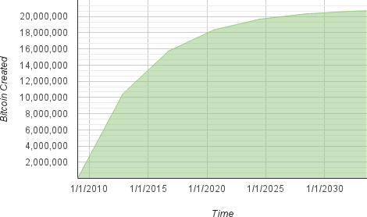
Bitcoin Economics: Bitcoin Money Supply
The limited and decreasing issuance makes a settled financial supply that opposes expansion
Dissimilar to a fiat money, which can be imprinted in unending numbers by a national bank, bitcoin can never be swelled by printing
Supply of bitcoin currency over time based on a geometrically decreasing issuance rate

Slide 7
So, how do we create Bitcoins?
By the process called Bitcoin Mining

Slide 8

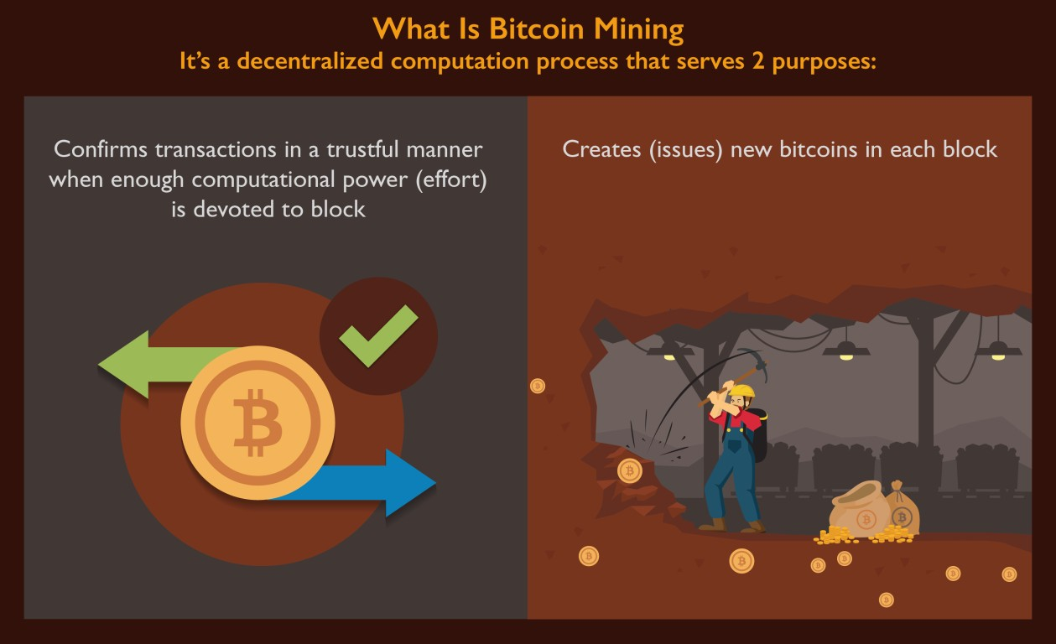
What is Bitcoin Mining?

Slide 9
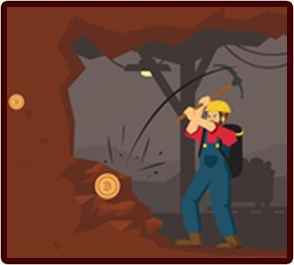

Bitcoin Mining: Types
There are two types of Bitcoin Mining:
Miners endeavours to produce new blocks all alone, with the returns from the
reward and transaction expenses going altogether to himself
Enabling miners to receive extensive payments with a higher variance (longer time between payments)
Solo Mining
Miner pools assets with different mineworkers to discover blocks all the more regularly, with the returns being shared among the pool miners in rough correlation to the measure of hashing power they each contributed
Enables the miner to receive little payments with a lower change (shorter time between payments)
Pooled Mining

Slide 10
Let’s first understand how Bitcoin Solo Mining works

Slide 11
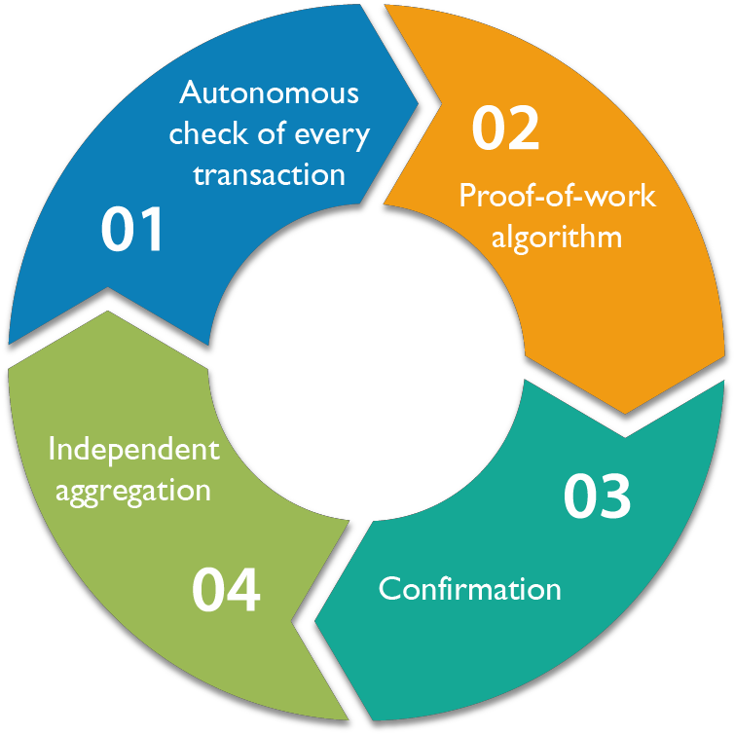
Mining & Consensus
Bitcoin’s consensus algorithm allows for the creation of new Bitcoins by the process of Mining.
It involves four steps:

Slide 12

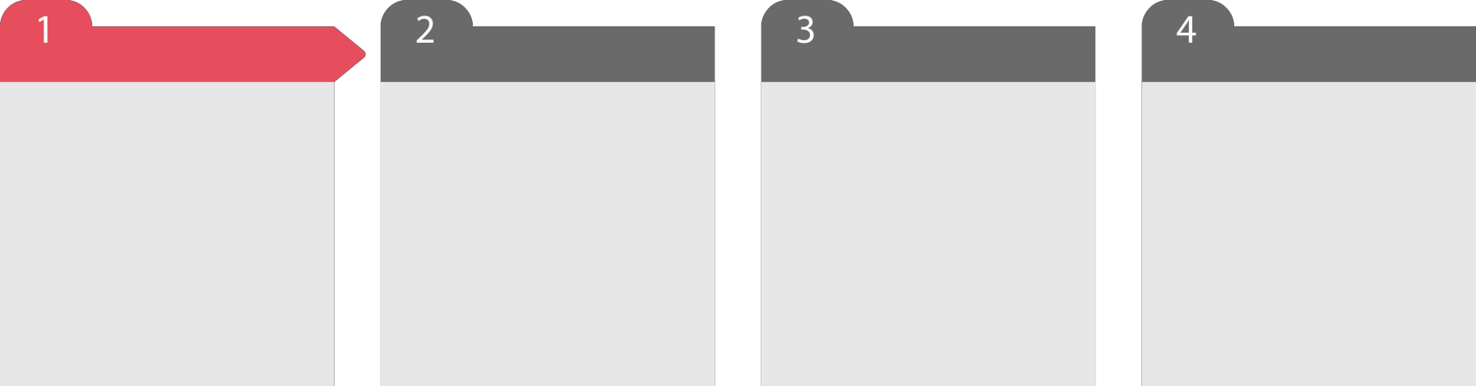
Autonomous Verification of Transactions
Autonomous check of every transaction, by each full node, in light of an extensive rundown of criteria
Independent aggregation of those transactions into new blocks by mining nodes combined with exhibited calculation through a proof-of-work algorithm
Independent confirmation of the new blocks by each node and get together into a chain
Independent selection, by every node, of the chain with the most cumulative computation demonstrated through proof of work

Slide 13
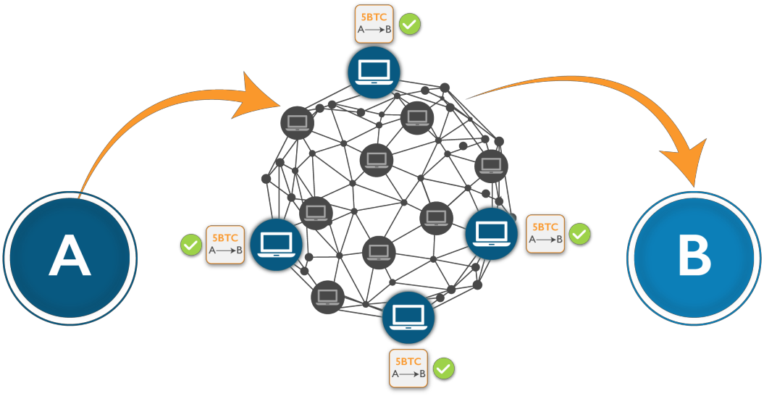
Independent Verification of Transactions
Let’s say, Andy initiates a transaction (of 5 BTC to Bob) in a bitcoin network:
Andy Bob
Before sending transactions to its neighbours, each bitcoin node that gets the transaction will
initially verify the transaction
This guarantees only valid transactions are propagated across the system while invalid transactions are disposed of at the first node which receive them

Slide 14

Checklist of Criteria
Every node confirms each transaction against a long agenda of criteria:
Transaction's punctuation and information structure must be right
Neither lists of inputs or outputs are empty
The transaction size in bytes is less than MAX_BLOCK_SIZE
Each output value, and also the aggregate, must be inside the permitted scope of
qualities (under 21m coins, more than 0)
A matching transaction in the pool, or in a block in the main branch, must exist
For each input, if the referenced output exists in any other transaction in the pool,
the transaction must be rejected
For each input, the referenced output must exist and cannot already be spent
Reject if the sum of input values is less than sum of output values

Slide 15

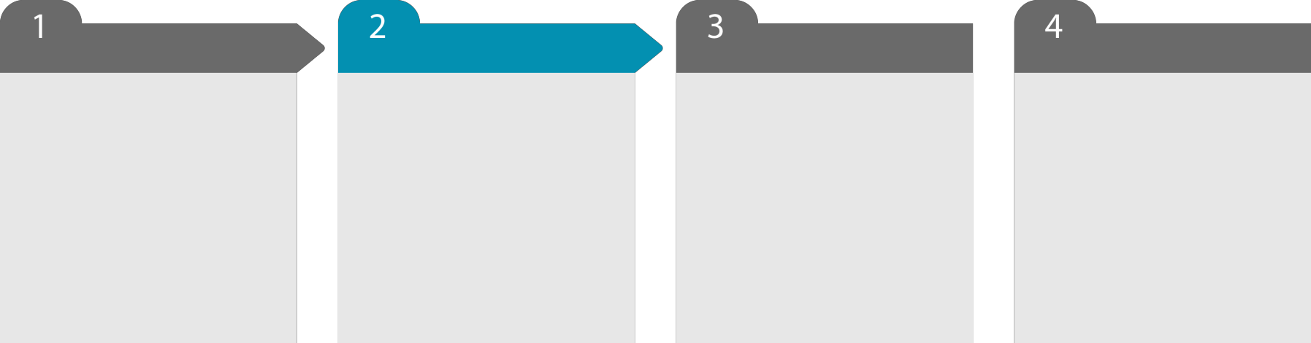
Aggregation of Verified Transactions
Autonomous check of every transaction, by each full node, in light of an extensive rundown of criteria
Independent aggregation of those transactions into new blocks by mining nodes combined with exhibited calculation through a proof-of-work algorithm
Independent confirmation of the new blocks by each node and get together into a chain
Independent selection, by every node, of the chain with the most cumulative computation demonstrated through proof of work

Slide 16
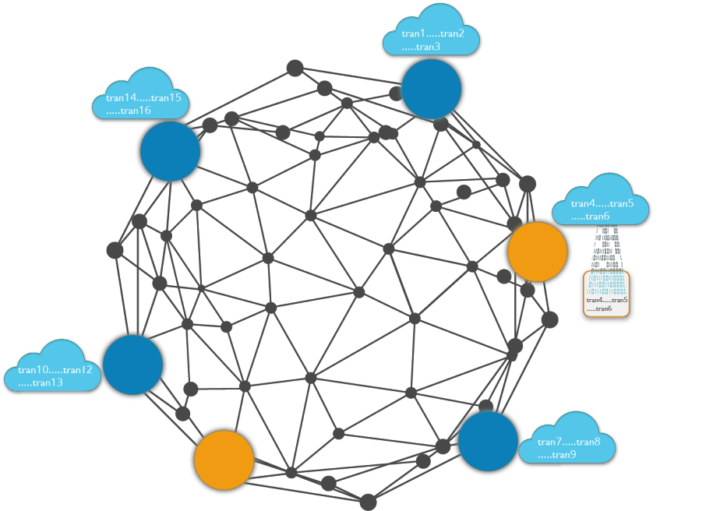
Aggregating Transactions into Blocks
By autonomously confirming every transaction as it is received and before propagating it, each node fabricates a pool of valid (however unconfirmed) transactions known as the transaction pool, memory pool or mempool
Transaction reaches Mining nodes it collects, validates, and relays new transactions just like other node
Unlike other nodes, miner node will then aggregate these transactions into a candidate block
In the network shown above, the miner nodes (in orange colour) aggregates the transactions in a candidate block

Slide 17













Aggregating Transactions into Blocks
Example: Let’s say Andy is a miner. (A mining node maintains a local copy of the blockchain, the list of all blocks created
since the beginning of the bitcoin system in 2009
As Andy’s node is mining, it receives block (say 273816) through the bitcoin network.
The arrival of this block
signifies the end of the competition for the block
During the previous 10
minutes, while Andy’s node was searching for a solution to block (273816) , it was also collecting transactions in preparation for the next block (273817)
Andy’s node is listening for transactions, trying to mine a new block and also listening for blocks discovered by other nodes
Upon receiving block (273816) and validating it, Andy’s node will also check all the transactions in the memory pool and remove any that were included in block (273816)
Whatever transactions remain in the memory pool are unconfirmed and are waiting to be recorded in a new block
By now it has collected a few hundred transactions in the memory pool
Andy’s node immediately constructs a candidate for block (273817) . This block is called a Candidate Block because it is not yet a valid block, as it does not contain a valid proof of work
The block becomes valid only if the miner succeeds in finding a solution to the proof-of-work algorithm

Slide 18
Now After collecting all the transactions in a block, Andy needs to construct the block header

Slide 19
Constructing a Block Header
To construct the block header, the mining node needs to fill in six fields, as listed in the table:
Size | Field | Description
4 bytes | Version | To construct the block header, the mining node needs to fill in six fields, as listed
32 bytes | Previous Block hash | A reference to the hash of the previous (parent) block in the chain
32 bytes | Merkle Root | A hash of the root of the merkle tree of this block’s transactions
4 bytes | Timestamp | The approximate creation time of this block (seconds from Unix Epoch)
4 bytes | Difficulty Target | The proof-of-work algorithm difficulty target for this block
4 bytes | Nonce | A counter used for the proof-of-work algorithm

Slide 20
Once Andy’s node has all the fields filled in the block header, Andy started Mining the block

Slide 21
Mining
With all the other fields filled, the block header is now complete and the process of mining can begin
The goal is now to find a value for the nonce that results in a block header hash that is less than the difficulty target
The mining node will need to test billions or trillions of nonce values before a nonce is found that satisfies the requirement
Now that a candidate block has been constructed by Andy’s node, it is time for Andy’s hardware mining rig to "mine" the block, to find a solution to the proof-of-work algorithm that makes the block valid

Slide 22
Now, to validate the block according to the proof-of-work
algorithm, Andy’s mining node has to reach the difficulty target. Let’s see how the difficulty is represented

Slide 23
Difficulty Representation
The block contains the difficulty target, in a notation called “difficulty bits" or just "bits“
Let’s say a block has 0x1903a30c as the difficulty bits. This notation expresses the difficulty target as a coefficient/exponent format, with the first two hexadecimal digits for the exponent and the next six hex digits as the coefficient
The formula to calculate the difficulty target from this representation is:
target = coefficient * 2^(8 * (exponent – 3))

Slide 24
Difficulty Equation
Difficulty retargeting occurs automatically and on every full node independently
Every 2,016 blocks, all nodes retarget the proof-of-work difficulty
The condition for retargeting difficulty measures the time it took to locate the last 2,016 blocks and compares that to the normal time of 20,160 minutes
The proportion between the real timespan and coveted timespan is figured and a comparing change (up or down) is made to the difficulty
The equation can be summarized as:
New Difficulty = Old Difficulty * (Actual Time of Last 2016 Blocks / 20160 minutes)

Slide 25
We have seen that Andy’s mining node has worked hard to reach the difficulty target. Let’s see what happens next

Slide 26
Successfully Mining the Block
As we saw earlier, Andy’s node has constructed a candidate block and prepared it for mining
Andy has several hardware mining rigs, each running the SHA256 algorithm in parallel at incredible speeds
The mining node running on Andy’s desktop transmits the block header to his mining hardware, which starts
testing trillions of nonces per second
Almost 11 minutes after starting to mine block, one of the hardware mining machines finds a solution and sends it back to the mining node
Immediately, Andy’s mining node transmits the block to all its peers
They receive, validate, and then propagate the new block. As the block ripples out across the network

Slide 27

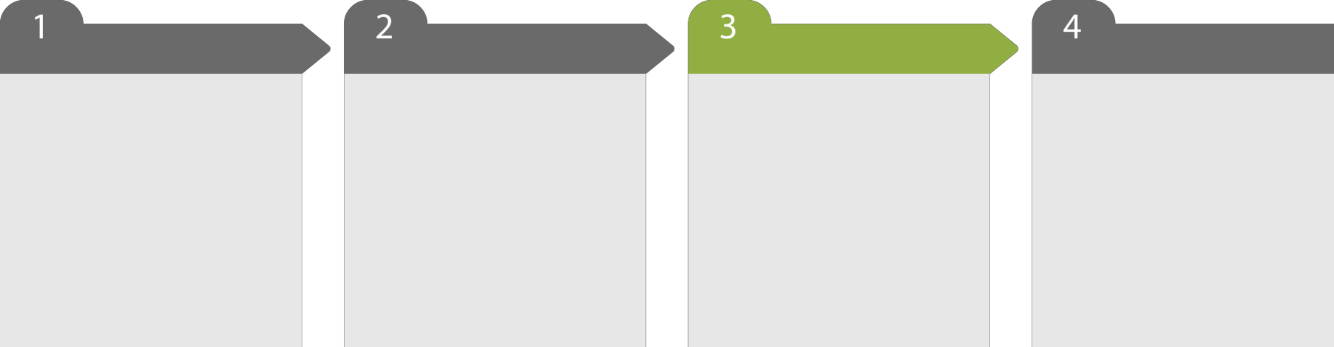
Independent Confirmation of each Block
Autonomous check of every transaction, by each full node, in light of an extensive rundown of criteria
Independent aggregation of those transactions into new blocks by mining nodes combined with exhibited calculation through a proof-of-work algorithm
Independent confirmation of the new blocks by each node and get together into a chain
Independent selection, by every node, of the chain with the most cumulative computation demonstrated through proof of work

Slide 28
Validating the New Block
In bitcoin’s consensus mechanism, each new block is validated independently by every node on the network
This ensures that only valid blocks are propagated on the network
Nodes validates the block by checking it against a long list of criteria that must all be met
The list includes:
The block structure is syntactically valid
The block header hash is less than the target difficulty (enforces the proof-of-work)
The block timestamp is less than two hours in the future (allowing for time errors)
The block size is within acceptable limits
The first transaction (and only the first) is a coinbase generation transaction
All transactions within the block are valid using the transaction checklist discussed in “Independent Verification of Transactions”

Slide 29

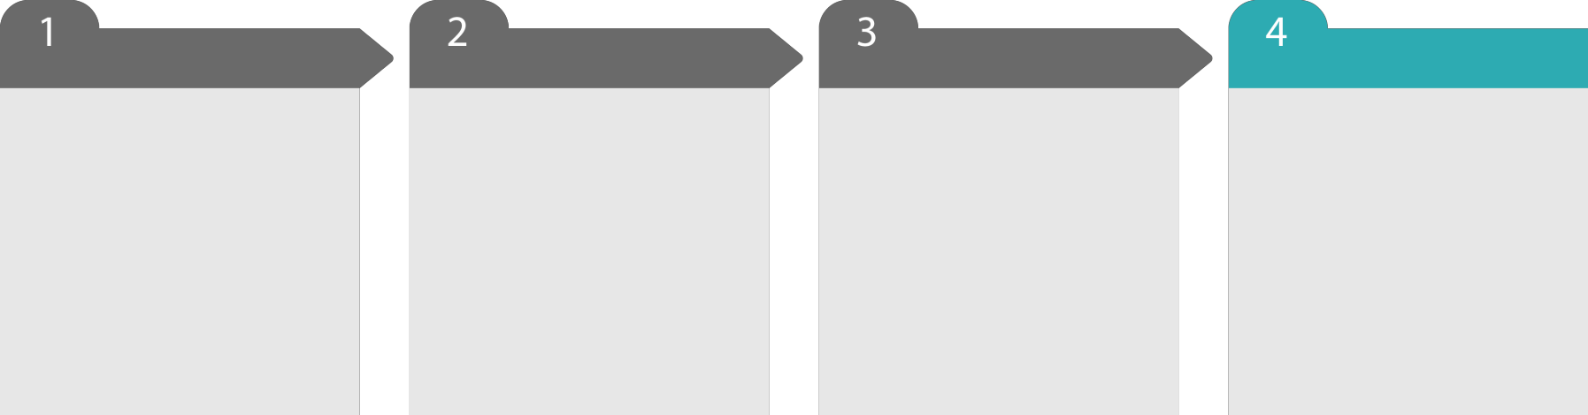
Independent Aggregation of the Block in the Chain
Autonomous check of every transaction, by each full node, in light of an extensive rundown of criteria
Independent aggregation of those transactions into new blocks by mining nodes combined with exhibited calculation through a proof-of-work algorithm
Independent confirmation of the new blocks by each node and get together into a chain
Independent selection, by every node, of the chain with the most cumulative computation demonstrated through proof of work

Slide 30
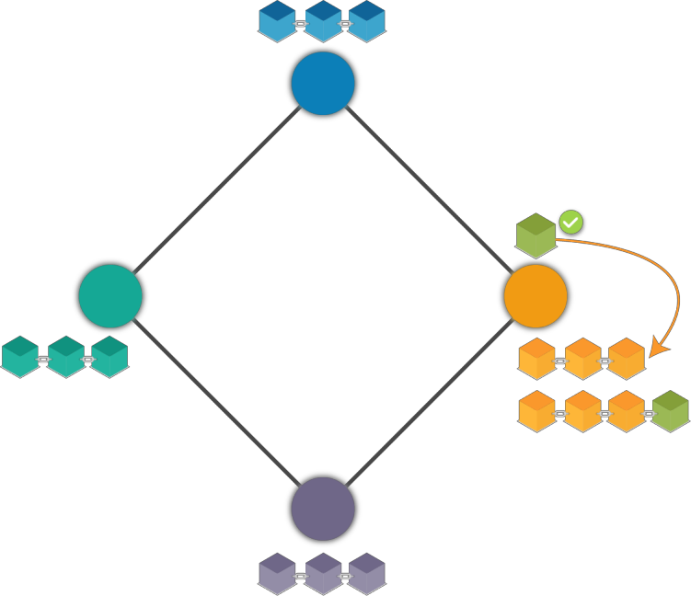
Assembling and Selecting Chains of Blocks
Once a node has validated a new block, it will then attempt to assemble a chain by connecting the block to the existing blockchain
Nodes maintain three sets of blocks:
Connected to the main blockchain
Forms branches off the main
blockchain and,
Which do not have a known parent in the known chains (orphans)
In the network shown above, once the node (in orange colour) validates the block, it assembles the chain by connecting the block in the existing blockchain

Slide 31
The Main Chain
The chain of blocks with the most cumulative difficulty associated with it
Under most conditions this is likewise the chain with the most blocks in it, unless there are two equivalent length chains and one has more confirmation of work
When a new block is received, a node will try to slot it into the existing blockchain
The node will look at the block’s "previous block hash" field, which is the reference to the new block’s parent
Then, the node will attempt to find that parent in the existing blockchain
Most of the time, the parent will be the "tip" of the main chain, meaning this new block extends the main chain

Slide 32
Secondary Chain
Sometimes, as we will see in “Blockchain Forks”, the new block extends a chain that is not the main chain
All things considered, the node will connect the new block to the secondary chain it expands and after that
compare the difficulty of the secondary chain to the main chain
If the secondary chain has more cumulative difficulty than the main chain, the node will reconverge on the secondary chain
It will select the secondary chain as its new main chain, making the old main chain a secondary chain
If the node is a miner, it will now construct a block extending this new, longer, chain

Slide 33
Orphan Blocks
If a valid block is received and no parent is found in the existing chains, that block is considered an "orphan“
Orphan blocks are saved in the orphan block pool where they will stay until their parent is received
Once the parent is received and linked into the existing chains, the orphan can be pulled out of the orphan pool and linked to the parent, making it part of a chain
Orphan blocks usually occur when two blocks that were mined within a short time of each other are received in reverse order (child before parent)

Slide 34
Bitcoins are thus Assembled in the Longest Chain
By choosing the greatest difficulty chain, all nodes in the long run accomplish organize wide consensus
Brief errors between chains are settled in the long run as more proof of work is included, broadening one of
the conceivable chains
Mining nodes "vote" with their mining power by picking which chain to extend out by mining the next block
When they mine another block and expand the chain, the new block itself speaks to their vote

Slide 35
So far we have seen how Solo Mining of Bitcoins works. However, solo Mining is becoming difficult, let’s find out why?

Slide 36
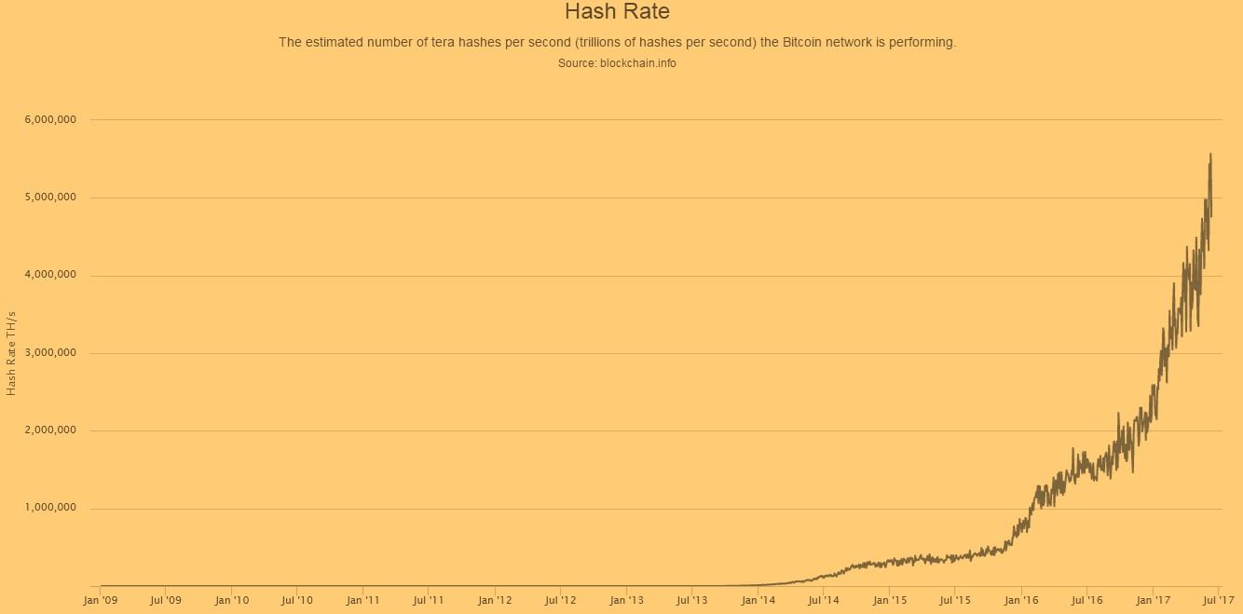
Mining & the Hashing Race
Bitcoin mining is a to a great degree aggressive industry
The hashing power has expanded exponentially each year of bitcoin's presence
The competition between miners and the growth of bitcoin has resulted in an exponential increase in the
hashing power (total hashes per second across the network)
The acquaintance of ASIC mining lead with another goliath jump in mining power, by setting the SHA256 work straightforwardly on silicon chips particular with the end goal of mining

Slide 37
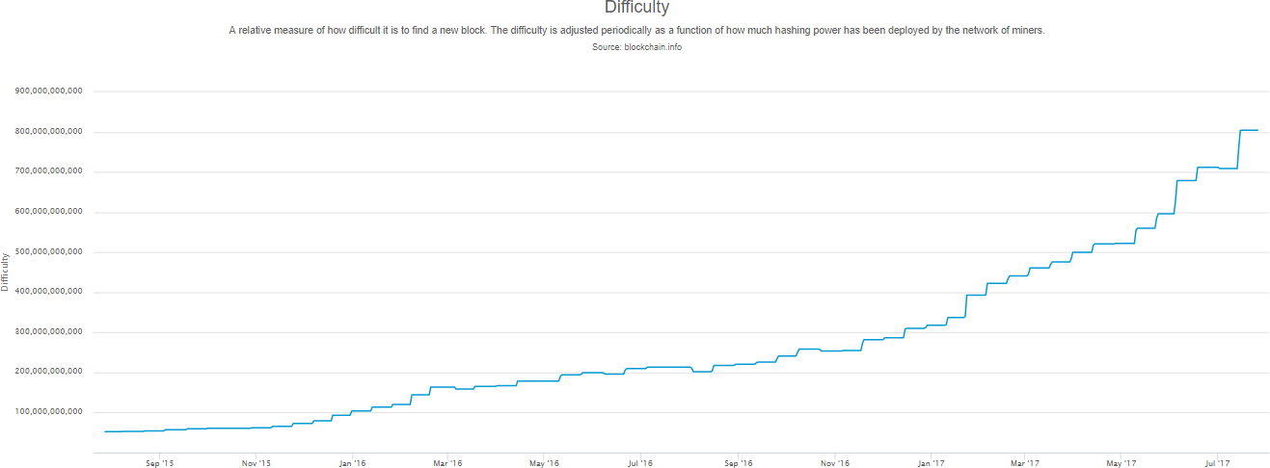
Difficulty Rises with the Hashing Power of the Miners
As the amount of hashing power applied to mining bitcoin has exploded, the difficulty has risen to match it
Total hashing power, in gigahashes per second, over two years

Slide 38
Since Solo Mining has become difficult with the increasing difficulty in the Bitcoin network, miners have started mining in the Pools. Lets see what are Mining Pools

Slide 39

Pooled Mining
Mining pools coordinate many hundreds or thousands of miners, over specialized pool-mining
protocols
The individual miners configure their mining equipment to connect to a pool server, after creating an account with the pool
The pool server will periodically make payments to the miners' bitcoin addresses, once their share of the rewards has reached a certain
threshold
Their mining hardware remains connected to the pool server while mining, synchronizing their efforts with the other miners
Successful blocks pay the reward to a pool bitcoin address, rather than individual
miners
The pool miners share the effort to mine a block and then share in the rewards
Miners participating in a pool split the work of searching for a solution to a candidate block, earning "shares" for their mining contribution

Slide 40
Difficulty Target in Pooled Mining
The mining pool sets a lower difficulty target for earning a share, typically more than 1,000 times easier than
the bitcoin network’s difficulty
When someone in the pool successfully mines a block, the reward is earned by the pool and then shared
with all miners in proportion to the number of shares they contributed to the effort
How does a mining pool measure the individual contributions, so as to fairly distribute the rewards, without the possibility of cheating?
The answer is to use bitcoin’s proof-of-work algorithm to measure each pool miner’s contribution, but set at a lower difficulty so that even the smallest pool miners win a share frequently enough to make it worthwhile to contribute to the pool

Slide 41
Types of Pooled Mining
There are several types of mining pool payout systems. The different payout systems are summarized below:
1. Pay Per Share (PPS)
The Pay-per-Share (PPS) approach is to offer an instant flat payout for each share that is solved
The payout is offered from the pool’s existing balance and can therefore be withdrawn immediately, without
waiting for a block to be solved or confirmed
The possibility of cheating the miners by the pool operator and by timing attacks is thus completely eliminated
This method results in the least possible variance for miners while transferring all risk to the pool operator
The resulting possibility of loss for the server is offset by setting a payout lower than the full expected value

Slide 42
Types of Pooled Mining..
2. Pay Per Last N Shares (PPLNS)
PPLNS has a higher payout. This is for people trying to mine as fast as possible
PPLNS will give you wide fluctuations in your 24 hour payout, but for hardcore miners, the law of large numbers states you will earn more this way

Slide 43


Copyright © 2017, edureka and/or its affiliates. All rights reserved.

Slide 44

Copyright © 2017, edureka and/or its affiliates. All rights reserved.

Slide 45


